Slide 1
United States Attorney’s Office Western District of Missouri U.S. Attorney Beth Phillips
www.usdoj.gov/usao/mow

Slide 2
Interagency Collaboration in the War on Terror

Slide 4
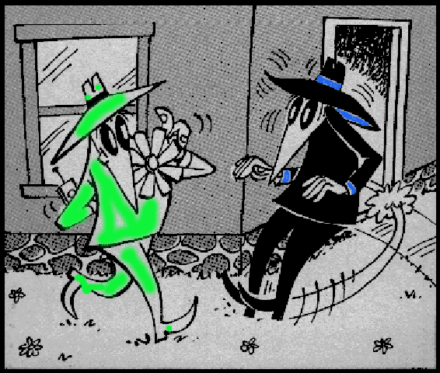
BALANCING INTELLIGENCE vs. PROSECUTION
Intelligence Gathering
Criminal Prosecution

Slide 5
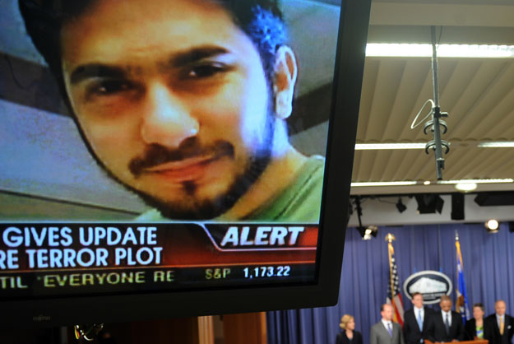
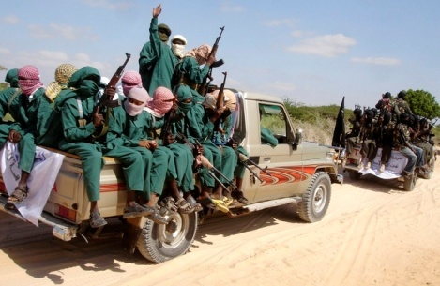
TYPES OF ANTI-TERRORISM CASES IN THE UNITED STATES
BOMB PLOTS
Times Square bomb plot
TERRORIST FIGHTING
Recruiting fighters
for Somalia
FINANCIAL AID
IARA
U.S. v. Ouazzani

Slide 6
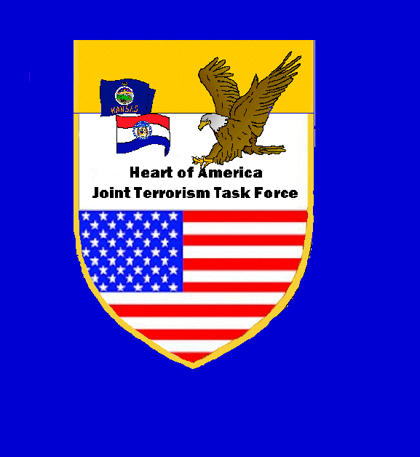
U.S. v. Ouazzanni Case Overview

Slide 7
How It All Started
USC lead identifies suspicious activity
GOAL: "Develop criminal case"
Two cases worked simultaneously:
White collar crime investigation for immediate arrest if circumstances demanded; and,
Intelligence-driven terrorism investigation to flesh out network and operational planning

Slide 8
How the Investigation Played Out
Frauds and other crimes
Money laundering
Funds handed over to AQ

Slide 9
Bank Fraud
Public Record Review
Ouazzani purchased 28 properties at foreclosure sales
Land records revealed that the purchase price, mortgage amount and appraised values were wildly different
Digging deeper, found Ouazzani falsified numerous details regarding income, purpose of the loan and value of collateral

Slide 10
Interstate Fraud
Public Record Review
Ouazzani obtained a $175,000 working capital loan for a business he owned, Truman Used Auto Parts
Submitted a false income tax return
Listed 9 properties as collateral but overstated the value of the properties
Failed to disclose he was married
Substantially overstated the value of business inventory and cash

Slide 11
Money Laundering
Subpoenaed information from over 30 financial accounts
Ouazzani transferred $165,000 from original account to a Bank of America account
Wired $112,000 to a bank in Dubai

Slide 12
Where the Money Went
Purchased an apartment in Dubai
Sold for $17,000 profit

Slide 13
Material Support
Provided $23,500 to Al Qaida
-$17,000 profit from apartment sale
-$6,000 additional

Slide 14
Material Support Consequences
$300 - 1x suicide bomber in Karachi
$1,500 -Jakarta Marriott - (12 dead)
$4,200 - UPS package bomb attempt
$4,320 - OKBOMB (168 dead)
$10,000 - USS Cole (17 dead)
$14,000 - London bombings (52 dead)
$18,000 - WTC I (6 dead)
$22,000 - Khobar Towers (19 dead)

Slide 15
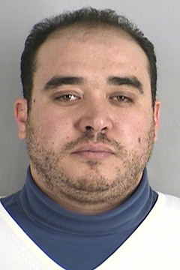
JTTF INTERROGATION
First Phase: Bank Fraud and Money Laundering questioning by FBI and DCIS
Miranda warnings after arrest, followed by detailed description of bank fraud and money laundering evidence
Defendant’s first admission: “I have made a lot of mistakes”
Defendant’s second admission: “I know we’re not just here to talk about bank fraud”

Slide 16
JTTF INTERROGATION
JTTF INTERROGATION
Second Simultaneous Phase: JTTF Interviews of 10+ family, business associates, and friends in Kansas City and New York (February 5, 2010)
Agents from numerous JTTF Agencies
Goals: Establish evidence of anti-American views, plans to flee the U.S., identity theft of relatives IDs as part of fraud and money laundering

Slide 17
JTTF INTERROGATION
Third Phase: Material Support to a Terrorist Organization, Al Qaeda, questioning by KCMOPD Task Force Officer and FBI
Closed circuit TV from interview room to JTTF agents, TFO’s, analysts, and support staff in separate room, who communicated with interviewers about questioning
Admissions by Defendant of material support, including swearing allegiance to Al Qaeda, discussing fighting overseas against the U.S., and providing money to Al Qaeda

Slide 18
How It All Ended
Agrees to plead to:
1 count bank fraud
1 count money laundering
1 count conspiracy to provide material support
Statutory sentencing options:
65 year sentence, no parole
$1MM fine +
Sentencing guidelines
≈ 30 years

Slide 19
Contact Us
United States Attorney’s Office
Western District of Missouri
400 E. Ninth Street, Fifth Floor
Kansas City, Missouri 64106
Ph: 816.426.3122
800.733.6558 (toll free)
Fax: 816.426.4210
www.usdoj.gov/usao/mow

